Slide 1

HELLO!
I am Sudheer Gupta

Slide 2
Study Hall

Slide 3
CARBON

Slide 4
CARBON:INTRODUCTION
Atomic Number: 6
Electronic configuration: 2, 4
Valence electrons: 4
Property: Non-metal

Slide 5
Abundance: Carbon is the 4th most abundant substance in universe and 15th most abundant substance in the earth’s crust.
Carbon compounds could only be obtained from a living source; hence they are also known as organic compounds.

Slide 6
Bonding In Carbon: Covalent Bond
Bond formed by sharing of electrons is called covalent bond.
Covalent bonds are of three types: Single, double and triple covalent bond.
Single Covalent Bond: Single covalent bond is formed because of sharing of two electrons, one from each of the two atoms.

Slide 7
Atomic Number of H = 1
Electronic configuration of H = 1
Valence electron of H = 1
Formation of hydrogen molecule (H2)
H
H
H + H
Valence electron
Single Bond
Shared pair of electron
H H
H₂

Slide 8
Valence electron of hydrogen = 1
Atomic number of chlorine = 17
Electronic configuration of chlorine: 2, 8, 7
Electrons in outermost orbit = 7
Valence electron = 7
Formation of hydrogen chloride (HCl):
H
Cl

Slide 9
Valence electron of chlorine = 7
Formation of chlorine molecule (Cl2):
Cl
Cl

Slide 10
Valence electron of hydrogen = 1
Atomic number of oxygen = 8
Electronic configuration of oxygen = 2, 6
Valence electron = 6
Formation of water (H2O):
H
O
H

Slide 11
Valence electron of carbon = 4
Valence electron of hydrogen = 1
Formation of Methane (CH4)
H
C
H
H
H

Slide 12
Valence electron of carbon = 4
Valence electron of hydrogen = 1
Formation of Ethane (C2H6):
H
H
C
C
H
H
H
H

Slide 13
Double bond is formed by sharing of four electrons, two from each of the two atoms.
Double covalent bond:
Formation of oxygen molecule (O2):
Valence electron of oxygen = 2
..
..
..
**
=
* *
O O O O
..
* *
..
**
* *

Slide 14
Valence electron of carbon = 4
Valence electron of oxygen = 6
In carbon dioxide two double covalent bonds are formed.
Formation of Carbon dioxide (CO2):
..
..
.
.
*
*
O C O CO2
..
.
.
..
*
*

Slide 15
Valence electron of carbon = 4
Valence electron of oxygen = 6
Formation of Carbon dioxide (CO2):
..
..
.
.
*
*
O C O CO2
..
.
.
..
*
*

Slide 16
Valence electron of carbon = 4
Valence electron of hydrogen = 1
Formation of Ethylene (C2H4):
H
H
C
C
H
H

Slide 17
Triple covalent bond is formed because of the sharing of six electrons, three from each of the two atoms.
Triple Covalent Bond:

Slide 18
Atomic number of nitrogen = 7
Electronic configuration of nitrogen = 2, 5
Valence electron = 5
Formation of Nitrogen (N2):
Triple bond is formed by the sharing of total electrons
N
N

Slide 19
In the formation of nitrogen, three electrons are shared by each of the nitrogen atoms. Thus one triple bond is formed because of the sharing of total six electrons.

Slide 20
Formation of Acetylene (C2H2):
Sharing of three pair of electrons
H
C
C
H

Slide 21
Properties of Covalent Bond:
Intermolecular force is smaller.
Covalent bonds are weaker than ionic bond. As a
result, covalent compounds have low melting and
boiling points.
Covalent compounds are poor conductor of electricity as
no charged particles are formed in covalent bond.

Slide 22
Allotropes Of Carbon
Diamond
Graphite
Fullerene

Slide 23
Diamond
Hard, clear, colorless crystals
The first element to have its structure determined by x-ray diffraction.
Has the highest melting point
The hardest of the naturally occurring solids.
The diamond lattice contains tetrahedral carbon atoms in an infinite three-dimensional network.

Slide 24
Graphite
The most thermodynamically stable form of carbon
a dark gray, waxy solid, used extensively as a lubricant
comprises the "lead" in pencils.
Graphite is also an infinite three-dimensional network
made up of planar offset layers of trigonal carbons forming fused hexagonal rings.

Slide 26
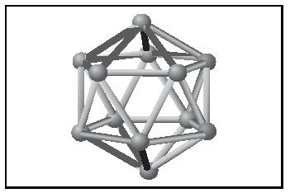
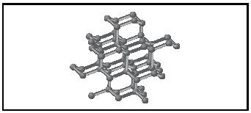

Slide 27
Diamond and graphite are non molecular allotropes of carbon. A range of molecular allotropes of carbon (the fullerenes) has been known since the discovery in 1985 of C 60. The sixty carbon atoms approximate a sphere of condensed five- and six-membered rings. Although initially found in the laboratory, fullerenes have since been shown to occur in nature at low concentrations. C 60 and C 70 are generally the most abundant and readily isolated fullerenes.

Slide 28
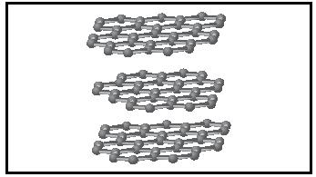
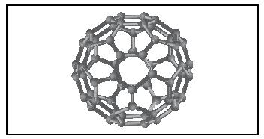
fullerene

Slide 29
Carbon can form bonds with other carbon atoms. This property of carbon is known as CATENATION. Because of catenation, carbon can form a long chain; while making bond with other carbon atoms. Carbon can make single, double and triple bonds by catenation.
Carbon can form branched chain; along with straight chain; while combining with carbon atoms, i.e. because of the property of catenation.

Slide 30
C C C C
Carbon can also form bonds with other types of monovalent atoms; apart from carbon. Carbon can make long chain combining with other atoms also. For example; carbon can form bonds with oxygen, hydrogen, nitrogen, etc.
c
c
c
c
c
c
c
c
c
c
c

Slide 31
O
R1 O C R2
CHO
H
OH
HO
H
H
OH
H
OH
CH2OH
Carbon-carbon bonds are very stable, which makes the compounds of carbon stable.

Slide 32
Hydrocarbon:
(Hydrogen + Carbon = Hydrocarbon)
Compounds formed because of the combination of hydrogen and carbon are known as hydrocarbons.
There are two types of hydrocarbon, viz. saturated hydrocarbon and unsaturated hydrocarbon.
Saturated hydrocarbons: Hydrocarbons having single bonds are known as SATURATED HYDROCARBONS.
Saturated hydrocarbons are known as ALKANE. These are also known as paraffin. Example: Methane, Ethane, Propane, etc.

Slide 33
Unsaturated hydrocarbon: Unsaturated hydrocarbons are of two types – Hydrocarbon with double bond and hydrocarbon with triple bond.
Hydrocarbon with double bond: Hydrocarbons having at least one double bond are known as ALKENE. Example: Ethylene, Propylene, Butylene, etc.
Hydrocarbon with triple bond: Hydrocarbons having at least one triple bond are known as ALKYNE. Example: Ethyne, Propyne, Butyne, etc.

Slide 34
Alkane
Hydrocarbons having only single bonds are known as alkane. These are saturated hydrocarbons. Alkane are also known as paraffin. The general formula of alkane is C_{n}H_{2n+2}

Slide 35
If C = 1, then; C_{n}H_{2n+2} = C₁H_{2x1+2} = CH₄
Name of this compound is methane. It can be shown by following structural formula:
H
H
C
H
H
Methane
If C = 2, then; C_{n}H_{2n+2} = C₂H_{2x2+2} = C₂H₆
Name of this compound is ethane. It can be shown by following structural formula:
H
H
H
C
C
H
H
H
Ethane

Slide 36
Structural formula of ethane can also be written as CH₃CH₃ or CH₃ − CH₃
If C = 3, then; C_{n}H_{2n+2} = C₃H_{2x3+2} = C₃H₈
Name of this compound is propane. It can be shown by following structural formula:
H
H
H
H
C
C
C
H
H
H
H
Propane
Structural formula of propane can also be written as CH₃CH₂CH₃ or CH₃ − CH₂ − CH₃

Slide 37
If C = 4, then; C_{n}H_{2n+2} = C₄H_{2x4+2} = C₄H₁₀
Name of this compound is butane. It can be shown by following structural formula:
H
H
H
H
H
C
C
C
C
H
H
H
H
H
Butane
Structural formula of butane can also be written as CH₃CH₂CH₂CH₃ or CH₃ − CH₂ − CH₂ − CH₃
If C = 5, then; C_{n}H_{2n+2} = C₅H_{2x5+2} = C₅H₁₂
Name of this compound is pentane. It can be shown by following structural formula
H
H
H
H
H
H
C
C
C
C
C
H
H
H
H
H
H
Pentane

Slide 38
Structural formula of pentane can also be written as CH₃CH₂CH₂CH₂CH₃ or CH₃ − CH₂ − CH₂ − CH₂ − CH₃
If C = 6, then; C_{n}H_{2n+2} = C₆H_{2x6+2} = C₆H₁₄
Name of this compound is hexane. It can be shown by following structural formula:
H
H
H
H
H
H
H
C
C
C
C
C
C
H
H
H
H
H
H
H
Hexane
Structural formula of hexane can also be written as CH₃CH₂CH₂CH₂CH₂CH₃ or
CH₃ − CH₂ − CH₂ − CH₂ − CH₂ − CH₃

Slide 39
Saturated Hydrocarbons (Alkane)
Name | No. of carbon atoms | Formula
Methane | 1 | CH₄
Ethane | 2 | C₂H₆
Butane | 3 | C₃H₈
Propane | 4 | C₄H₁₀
Pentane | 5 | C₅H₁₂
Hexane | 6 | C₆H₁₄
Heptane | 7 | C₇H₁₆
Octane | 8 | C₈H₁₈
Nonane | 9 | C₉H₂₀
Decane | 10 | C₁₀H₂₂

Slide 40
Alkene: Hydrocarbons having at least one double bond between two carbon atoms are known as ALKENE.
General formula of alkene is C_{n}H2n; where n is number of carbon atoms.
If C = 1 then C_{n}H_{2n} = C₁H_{2x1} = CH₂
Name of this compound: Since, hydrocarbon having one carbon atom is known as Methane. Thus, Methane – ane + ene = Methene. But, alkene does not exist with one carbon atom, thus, methene does not exist.
If C = 2 then C_{n}H_{2n} = C₂H_{2x2} = C₂H₄
Name of this compound is: ethane − ane + ene = ethene. This molecule can be shown by following structural formula.
Unsaturated Hydrocarbons
H
H
C = C
H
H

Slide 41
If C = 3 then C_{n}H_{2n} = C₃H_{2x3} = C₃H₆
Name of this compound is: propane − ane + ene = propene. This molecule can be shown by following structural formula.
H
H
H
H
C
C
C
H
H
Propene
Other alkenes are formed in similar way.

Slide 42
Hydrocarbons having at least one triple bond between two carbon atoms are known as alkyne. (Alkane – ane + yne = Alkyne). Similarly;
Ethane – ane + yne = Ethyne
Propane – ane + yne = Propyne
Butane – ane + yne = Butyne
Pentane – ane + yne = Pentyne
General formula of alkyne is C_{n}H_{2n − 2}. As in case of alkene, minimum two carbon atoms are required to form alkyne.
If C = 2, then; C_{n}H_{2n − 2} = C₂H_{2x2 − 2} = C₂H₂
The name of this compound is ethyne.
Alkyne
H
C
C
H
Ethyne

Slide 43
If C = 3, then; C_{n}H_{2n − 2} = C₃H_{2x3 − 2} = C₃H₄
The name of this compound is propyne.
H
H
C
C
C
H
Propyne
H
If C = 4, then; C_{n}H_{2n − 2} = C₄H_{2x4 − 2} = C₄H₆
The name of this compound is butyne.
H
H
H
C
C
C
C
H
H
H
Butyne
Other alkynes are formed in similar way.

Slide 44
H
H
H
H
H
H
H
H
H
H
H
H
C
C
C
C
C
H
H
C
C
C
C
C
C
H
H
H
H
H
H
H
H
H
H
H
H
Pentane
Hexane
H
H
H
H
C
H
C
H
H
H
C
C
H
C
C
H
H
H
H
H
C
C
C
C
H
H
C
H
H
H
H
Cyclopentatne
H
H
Cyclohexane
H2
C
C
C
H2
H2
Cyclopentatne
C
C
Cyclohexane
H2
H2

Slide 45
H
H
H
C
H
H
H
C
C
C
C
H
C
H
H
H
(a)Benzene
H
H
(b)Benzene
H
H
H
H
H
H
H
H
H
H
(e)Benzene
(f)Benzene
H
H
(c)Benzene
(d)Benzene

Slide 46
Hydrocarbons: Nomenclature
Functional Group:
Single atom or group of atoms, that have similar chemical properties are called functional group. For example: Halogen group, Carboxyl group, Aldehyde group, etc.
Alkyl group: −R
is known as alkyl group.
Examples: −CH₃ (Methyl) −C₂H₅ (Ethyl), −C₃H₇ (Propyl)
H
H
H
H
H
H
H
C
H
C
C
H
C
C
C
H
H
H
H
H
H
Methyl group
Ethyl group
Propyl group

Slide 47
Halogen group: Halogen group is also known as halo group. −Cl (Chloro),−Br(Bromo),−I(Iodo) are halogen or halo group.
Alcohol: −OH is known as alcohol group.
Aldehyde: −CHO is known as aldehyde group. Its structural formula is as follows:
O
H
C
H
Or
C
O
Ketone Group: −CO− is known as ketone group. This is also known as carbonic group. Its structural formula is as follows:
O
Or
C
O
C

Slide 48
Carboxylic Acid Group: −COOH is known as carboxylic acid group; or simply as acid group. Its structural formula is as follows:
O
OH
Or
C
O
C
OH

Slide 49
International Union of Pure and Applied Chemistry (IUPAC) decided some rules to name the carbon compounds. This was done to maintain the uniformity throughout the world. Names which are given on this basis are popularly known as IUPAC name. The rules for nomenclature are as follows:
Identify the number of carbon atoms in carbon compound. Name the carbon compounds according to the number of carbon atoms.
Example: Saturated hydrocarbon having one carbon atom is named as Methane. Saturated hydrocarbon having two carbon atoms is named as Ethane.
Nomenclature of Carbon Compounds:

Slide 50
Unsaturated hydrocarbon with double bond having two carbon atoms is named as Ethene.
Unsaturated hydrocarbon with triple bond between carbon atoms is named as Ethyne.
If the structure has branched chain, identify the longest chain and then identify the number of carbon atoms. To understand this, let us observe following examples:

Slide 51
C
9
C
8
C
C
7
7
C
C
6
6
C C C C C C C C
C C C C C C C C
1 2 3 4 5 6 7 8
1 2 3 4 5 6 7 8
a
b
In figure (a) the longest chain has eight carbon atoms, and thus the name of parent compound would be octane. In figure (b) longest chain has nine carbon atoms, and thus the name of parent compound would be nonane.
Identify the longest chain. Then number the carbon atoms in such a fashion that the functional group; if any; would come at the lowest number.

Slide 52
C
7
C
6
8 7 6 5 4 3 2 1
C C C C C C C C
1 2 3 4 5 6 7 8
C
In the given figure (c), while counting from right to left (in red color), branched chain which is functional group falls at the fourth position. On the other hand, while counting from left to right, the branched chain falls at the fifth position. In this case, the numbering from right to left is taken because then only the functional would be at the lowest position.
In case of a functional group present, write the prefix or suffix of the functional group according to the table given here. Then write the name of the parent compound.

Slide 53
Functional group | Prefix | Suffix
Alkyl | Alkyl | n/a
Halogen | Chloro− for chlorine, Bromo− for bromine Iodo− for iodine | n/a
Alcohol | n/a | ol
Aldehyde | n/a | al
Ketone | n/a | one
Carboxylic acid | n/a | oic acid
Double bond | n/a | ene
Triple bond | n/a | yne

Slide 54
Nomenclature of Alkane:
Example: In this structure, there are four carbon atoms but no functional group is attached. Hence, its name is butane
H
H
H
H
H
C
C
C
C
H
H
H
H
H
n-butane

Slide 55
Common name: Iso-butane.
IUPAC Name:
Number of carbon atoms in the longest chain = 3.
A methyl group is present at carbon number 2.
So, IUPAC Name is 2-methyl propane.
H
H
H
H
H
C
C
C
H
H
C
H
H
H
H
H
C
H
C
C
C
H
H
H
H
H
H
H
Iso-butane
Iso-butane

Slide 56
Example: Since there are five carbon atoms, hence its IUPAC name is pentane. Its common name is n-pentane.
H
H
H
H
H
H
H
H
H
H
C
C
C
H
4 3 2 1
C
C
H
C
C
C
C
H
1 2 3 4 5
1 2 3 4
H
H
H
H
H
H
H
H
Pentane
H
C
H
H
Pentane
Isopentane

Slide 57
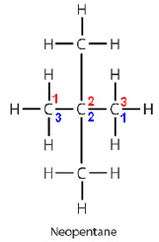
IUPAC Name:
Numbering of carbon atoms is done in two ways, i.e. from left to right and from right to left.
The number of carbon atoms in the longest chain = 4.
A methyl group (functional group) is attached with this chain.
Thus, name of parent compound is Butane.
In the numbering from left to right functional group falls at second number while in the numbering from right to left; the functional group falls at 3rd position.
Therefore, IUPAC name of this compound is 2-methyl butane.
Example: The common name of this compound is neopentane.
H
H
C
H
H
H
H
H
1 2 3
C
C
C
H
3 2 1
H
H
C
H
H
Neopentane

Slide 58
Hydrocarbons: Nomenclature Part 2
Naming of hydrocarbon with Halo group:
Example: (CH₃Cl) The common name of this molecule is methyl chloride. There is one carbon atom in this compound. So its parent name is Methane. Since one chloro group is present in this compound, hence its IUPAC name is chloro-methane. Following is the structural formula of chloro-methane.
H
H
C
Cl
H

Slide 59
Example: (C₃H₇Cl) The common name of this compound is propyl chloride.
IUPAC Name:
Number of carbon atoms = 3
Functional group: Chloro
Thus, IUPAC Name is Chloro-propane.
Following is the structural formula of chloro-pentane.
H
H
H
H
C
C
C
Cl
H
H
H

Slide 60
Example: C₃H₇Br
Common name of this compound is propyl bromide. Its IUPAC name is bromo-propane. Following is the structural formula of bromo-propane:
H
H
H
H
C
C
C
Br
H
H
H

Slide 61
Example: CH₃H₇I
Common name of this compound is hexyl iodide. Its IUPAC name is iodo-hexane. Following is the structural formula of iodo-hexane:
H
H
H
H
H
H
H
C
C
C
C
C
C
I
H
H
H
H
H
H

Slide 62
Naming of alcohol group
Example: CH₃OH
The common name of this compound is methyl alcohol.
IUPAC Name:
Number of carbon atom: 1
Functional group: Alcohol (suffix : ol)
IUPAC Name: Methane – e Methane – e + ol = Methanol.
Following is the structural formula of methanol.
H
H
C
OH
H

Slide 63
Example: CH₃CH₂OH
The common name of this compound is ethyl alcohol.
IUPAC Name:
Number of carbon atoms: 2
Functional group: Alcohol
Hence, IUPAC name is ethanol.
Following is the structural formula of ethanol.
H
H
H
C
C
OH
H
H

Slide 64
Example: C₆H₁₃OH
The common name of this compound is hexyl alcohol.
IUPAC Name:
Number of carbon atoms: 6
Functional group: Alcohol
Hence, its IUPAC name is hexanol
Following is the structural formula of hexanol.
H
H
H
H
H
H
H
C
C
C
C
C
C
OH
H
H
H
H
H
H

Slide 65
Naming of Aldehyde group (−CHO):
IUPAC name of alkane having aldehyde group is written as follows:
The suffix of aldehyde group is “al”.
Alkane – e + al = Alkanal
Methane – e + al = Methanal
Ethane – e + al = Ethanal, and so on.
Example: HCHO
Common name of this compound is formaldehyde.
IUPAC Name:
Number of carbon atom: 1
Hence, IUPAC name is methanal.
Following is the structural formula of methanal.
O
O
H
C
H
or
C
H
H

Slide 66
Example: CH₃CHO
Common name of this compound is acetaldehyde.
IUPAC Name:
Number of carbon atoms: 2
Functional group: Aldehyde
Hence, IUPAC name is ethanal.
Following is the structural formula of ethanal.
H
H
O
O
H
C
C
H
C
C
or
H
H
H
H

Slide 67
Example: C₆H₁₃CHO
Number of carbon atoms in this compound is 7 and hence, its IUPAC name is heptanal.
H
H
H
H
H
H
O
H
C
C
C
C
C
C
C
H
H
H
H
H
H
H

Slide 68
Naming of Carboxylic Acid (−COOH):
Suffix for carboxylic acid is ‘oic acid”.
Thus an alkane having carboxylic acid is named as:
Methane – e + oic acid = Methanoic acid
Ethane – e + oic acid = Ethanoic acid.
Answer: HCOOH
Common name of this compound is formic acid. It has one carbon atom, hence its IUPAC name is methanoic acid. Following is the structural formula of methanoic acid.
O
O
H
C
O
H
or
C
H
H
O

Slide 69

Example: CH₃COOH
Common name of this compound is acetic acid. It has two carbon atoms, hence its IUPAC name is ethanoic acid. Structural formula of ethanoic acid is as follows:
H
H
C
C
O
H
H
Example: C₄H₉COOH
It has five carbon atoms, hence its IUPAC name is pentanoic acid. Structural formula of pentanoic acid is as follows:
H
H
H
H
H
O
H
C
C
C
C
C
C
O
H
H
H
H
H
H

Slide 70
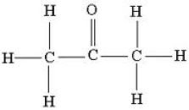
Naming of Ketone (−CO−):
Example: CH₃−CO−CH₃
Common name of this compound is dimethyl ketone.
It has three carbon atoms and functional group is ketone, hence its IUPAC name is propanone.
Structural formula of propanone is as follows:
H
O
H
H
C
C
C
H
H
H
Example: C₂H₅−CO−C₂H₅
Common name of this compound is dethyl ketone.
It has five carbon atoms and functional group is ketone, hence its IUPAC name is pentnone.
Following is the structural formula of pentanone:
H
H
O
H
H
H
C
C
C
C
C
H
H
H
H
H

Slide 71
Homologous Series:
Series of compounds with same general formula and functional group is known as homologous series.
Compounds belonging to the same homologous series show similar properties.
Compounds of homologous series differ by CH₂ from their consecutive members.
Each subsequent compound in a homologous series differs by 14 au.
Example: Alkanes; such as, Methane, Ethane, Propane, Butane, etc. belong to same homologous series.

Slide 72
Chemical Properties of Carbon Compounds
Combustion Reaction: Carbon and carbon compounds gives carbon dioxide, vapor, heat and light on burning in air.
C + O₂ ⇨ CO₂ + Heat + Light
CH₄ + 2O₂ ⇨ CO₂ + 2H₂O + Heat + Light
CH₃C₂OH + O₂ ⇨ CO₂ + H₂O + Heat + Light
Oxidation:
In combustion reaction, carbon compounds are oxidized in the presence of oxygen.
The following example is different because alkaline KMnO4 is the oxidizing agent in this reaction.
CH₃CH₂OH + (Alkaline KMnO₄/Acidified K₂Cr₂O₇) ⇨ CH₃COOH

Slide 73

Addition Reaction:
Ethene is converted into ethane when heated with the catalyst nickel.
CH₂=CH₂ + H₂ + (Nickel catalyst) ⇨ CH₃−CH₃
When Ethene undergoes addition reaction with chlorine, it gives dichloroethane.
Substitution Reaction:
Replacement of a functional group or any atom by another atom or functional group is known as substitution reaction.
When methane reacts with chlorine gas in the presence of sunlight, it gives chloromethane and hydrogen chloride.
CH₄ + Cl₂ + Sunlight ⇨ CH₃Cl + HCl
Similarly, ethane gives chloroethane when it reacts with chlorine in the presence of sunlight.
C₂H₆ + Cl₂ + Sunlight ⇨ C₂H₅Cl + HCl

Slide 74
Some Important Organic Compounds
Ethanol (C₂H₅OH)
Ethanol is commonly known as alcohol and spirit.
General name of ethanol is ethyl alcohol.
Ethanol is the main constituent of all alcoholic drinks
Ethanol is soluble in water
Ethanol is a very good solvent
Ethanol is used in manufacturing of medicines, such as tincture iodine, cough syrup, etc.
Taking even small quantity of pure ethanol may prove lethal
Taking dilute ethyl alcohol can cause drunkenness

Slide 75
1.Reaction of ethanol with sodium metal:
It gives sodium ethoxide and hydrogen gas.
2CH₃CH₂OH + 2Na ⇨ 2CH₃CH₂ONa + H₂
2.Oxidation of ethanol:
Ethanol gives ethanoic acid on oxidation.
CH₃CH₂OH + (Alkaline KMnO₄/Acidified K₂Cr₂O₇) ⇨ CH₃COOH
3.Dehydration of ethanol:
Ethanol gives ethene and water when it is heated with concentrated sulphuric acid.
CH₃CH₂OH + Conc. H₂SO₄ ⇨ CH₂=CH₂ + H₂O

Slide 76

Ethanoic Acid (CH₃COOH)
Structural formula of ethanoic acid is as follows:
General name of ethanoic acid is acetic acid.
Ethanoic acid freezes in winter and hence it is also known as glacial acetic acid.
Ethanoic acid is a colorless liquid.
5% to 8% solution of acetic acid in water is known as vinegar.
Reaction of ethanoic acid with base:
Ethanoic acid gives sodium acetate when it reacts with sodium hydroxide.
CH₃COOH + NaOH ⇨ CH₃COONa + H₂O
Esterificaiton of ethanoic acid:
Ethanoic acid gives ethyl acetate when it reacts with ethanol in presence of conc. sulphuric acid. This reaction is called esterification reaction.
CH₃COOH + C₂H₅OH ⇨ CH₃COOC₂H₅ + H₂O

Slide 77
The IUPAC name of Ethyl acetate is Ethyl Ethanoate.
Ethyl acetate is also known as ester. Ester is a sweet smelling compound.
It is used in making perfumes and as a flavouring agent.
When ethyl ethanoate reacts with a base or acid, it gives back ethanol and ethanoic acid.
CH₃COOC₂H₅ + NaOH ⇨ CH₃COOH + C₂H₅OH
This reaction is called saponification,
since it is used in making of soap.
Hydrolysis of ester (Ethyl ethanoate):
Ethyl ethanoate gives parent alcohol and sodium ethanoate when heated with sodium hydroxide solution.
CH₃COOC₂H₅ + NaOH ⇨ CH₃COONa + C₂H₅OH
Saponification:
Ester of higher fatty acids gives sodium salt of higher fatty acid; when heated with glycerol and sodium hydroxide. Sodium salts of higher fatty acid are known as soaps. This reaction is called saponification (soap making).
Reaction of ethanoic acid with sodium carbonate and sodium bicarbonate:
Ethanoic acid gives sodium acetate, water and carbon dioxide when reacts with sodium carbonate or sodium bicarbonate (sodium hydrogen carbonate).
2CH₃COOH + Na₂CO₃ ⇨ 2CH₃COONa + CO₂ + H₂O
CH₃COOH + NaHCO₃ ⇨ CH₃COONa + CO₂ + H₂O

Slide 78
Soaps and Detergents:
Soap:
Ester of higher fatty acids is called soap. It is manufactured by the reaction of easter of higher fatty acid with sodium hydroxide. The sodium salt so formed has cleansing property.
Detergent:
Soap cannot form lather in hard water. To overcome this problem, detergents were introduced. Detergent is also known as soapless soap. Detergent is sodium salt of benzene sulphonic acid or sodium salt of long chain alkyl hydrogen sulphate.
Cleansing action of soap:
Soap molecule has two ends. One end is hydrophilic and another end is hydrophobic. In other words, one end is lipophobic (hydrophilic) and another end is lipophilic (hydrophobic). When soap is dissolved in water and clothes are put in the soapy solution, soap molecules converge in a typical fashion to make a structure; called micelle. The hydrophobic ends of different molecules surround a particle of grease and make the micelle; which is a spherical structure. In this, the hydrophilic end is outside the sphere and hydrophobic end is towards the centre of the sphere. That is how, soap molecules wash away dirt and grease by making micelles around them.

Slide 79
Soap and Hard Water:
Hard water often contains salts of calcium and magnesium. Soap molecules react with the salts of calcium and magnesium and form a precipitate. This precipitate begins floating as an off-white layer over water. This layer is called scum. Soaps lose their cleansing property in hard water because of formation of scum. Detergents are used; instead of soaps; in hard water to overcome the problem. Detergents are usually ammonium or sulphonate salts of carboxylic acids. The charged ends of these compounds do not form precipitate with calcium or magnesium salts in hard water. Hence, detergents retain their cleansing property in hard water.

Slide 80
Transition headline
1
Let’s start with the first set of slides

Slide 81
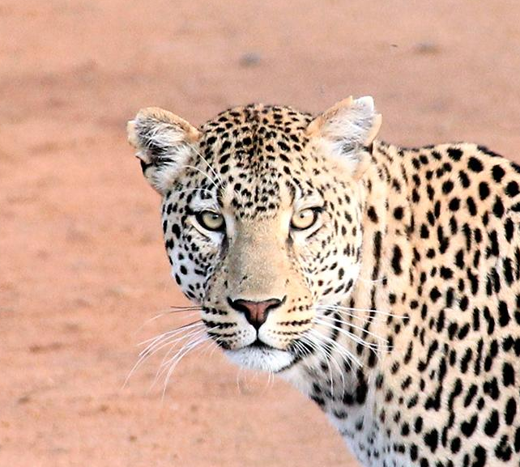
Hello!
I am Jayden Smith
I am here because I love to give presentations.
You can find me at @username

Slide 82
Quotations are commonly printed as a means of inspiration and to invoke philosophical thoughts from the reader.

Slide 83
BIG concept
Bring the attention of your audience over a key concept using icons or illustrations

Slide 84
You can also split your content
White
Is the color of milk and fresh snow, the color produced by the combination of all the colors of the visible spectrum.
Black
Is the color of coal, ebony, and of outer space. It is the darkest color, the result of the absence of or complete absorption of light.

Slide 85
In two or three columns
Yellow
Is the color of gold, butter and ripe lemons. In the spectrum of visible light, yellow is found between green and orange.
Blue
Is the colour of the clear sky and the deep sea. It is located between violet and green on the optical spectrum.
Red
Is the color of blood, and because of this it has historically been associated with sacrifice, danger and courage.

Slide 86

A picture is worth a thousand words
A complex idea can be conveyed with just a single still image, namely making it possible to absorb large amounts of data quickly.

Slide 87

Want big impact?
Use big image.

Slide 88
Use charts to explain your ideas
White
Gray
Black

Slide 89
And tables to compare data
 | A | B | C
Yellow | 10 | 20 | 7
Blue | 30 | 15 | 10
Orange | 5 | 24 | 16

Slide 90
Maps
our office

Slide 91
89,526,124
Whoa! That’s a big number, aren’t you proud?

Slide 92
89,526,124$
185,244 users
100%
That’s a lot of money
And a lot of users
Total success!

Slide 93
Our process is easy
first
second
last

Slide 94
Our sales funnel
20%
40%
60%
80%
Diagram featured by http://slidemodel.com
100%

Slide 95
Let’s review some concepts
Yellow
Is the color of gold, butter and ripe lemons. In the spectrum of visible light, yellow is found between green and orange.
Blue
Is the colour of the clear sky and the deep sea. It is located between violet and green on the optical spectrum.
Red
Is the color of blood, and because of this it has historically been associated with sacrifice, danger and courage.
Yellow
Is the color of gold, butter and ripe lemons. In the spectrum of visible light, yellow is found between green and orange.
Blue
Is the colour of the clear sky and the deep sea. It is located between violet and green on the optical spectrum.
Red
Is the color of blood, and because of this it has historically been associated with sacrifice, danger and courage.

Slide 96
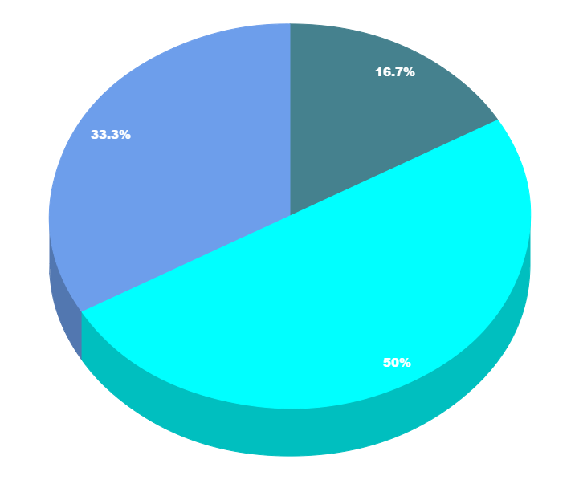
You can copy&paste graphs from Google Sheets

Slide 97
Place your screenshot here
Android project
Show and explain your web, app or software projects using these gadget templates.

Slide 98
Place your screenshot here
iPhone project
Show and explain your web, app or software projects using these gadget templates.

Slide 99
Place your screenshot here
Tablet project
Show and explain your web, app or software projects using these gadget templates.

Slide 100
Place your screenshot here
Desktop project
Show and explain your web, app or software projects using these gadget templates.

Slide 101
Thanks!
Any questions?
You can find me at:
@username
user@mail.me

Slide 102
Credits
Special thanks to all the people who made and released these awesome resources for free:
Presentation template by SlidesCarnival
Photographs by Unsplash

Slide 103

Presentation design
This presentation uses the following typographies and colors:
Titles: Nixie One
Body copy: Muli
You can download the fonts on this page:
http://www.google.com/fonts#UsePlace:use/Collection:Nixie+One|Muli:300,400,300italic,400italic
Click on the “arrow button” that appears on the top right
Aquamarina #00e1c6 / Turquoise #19bbd5 / Skyblue #2c9dde /
Light gray #c6daec / Dark blue #0e293c
You don’t need to keep this slide in your presentation. It’s only here to serve you as a design guide if you need to create new slides or download the fonts to edit the presentation in PowerPoint®

Slide 104
SlidesCarnival icons are editable shapes.
This means that you can:
Resize them without losing quality.
Change fill color and opacity.
Change line color, width and style.
Isn’t that nice? :)
Examples:

